Slide 1

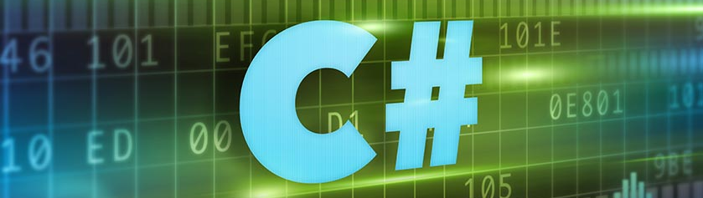
C# Intermediate

Slide 2
What will we learn?
Arrays
Lists
Associative arrays
Foreach loop
Methods
Call by Value
Call by Reference
Out parameter
Text Processing
Objects and classes /basics/
Structures
Enums
Bitwise operators
Regular Expressions
Nullables

